Slide 1

Project Management: 5 Basics for Success
Information Technology Services| HUTCHINSON COMMUNITY COLLEGE

Slide 2

My Info
Mandie Ann Lyons
Chief Information Officer
Hutchinson Community College
Email: lyonsm@hutchcc.edu
LinkedIn: linkedin.com/in/mandie-lyons-hutchcc
Github: github.com/mandieannlyons
Repo: github.com/mandieannlyons/PM-5-Basics

Slide 3
Start with the Basics
Establish the charter
Build influence
Lead effective meetings
Evaluate risks/gaps
Manage change
Information Technology Services| HUTCHINSON COMMUNITY COLLEGE

Slide 4
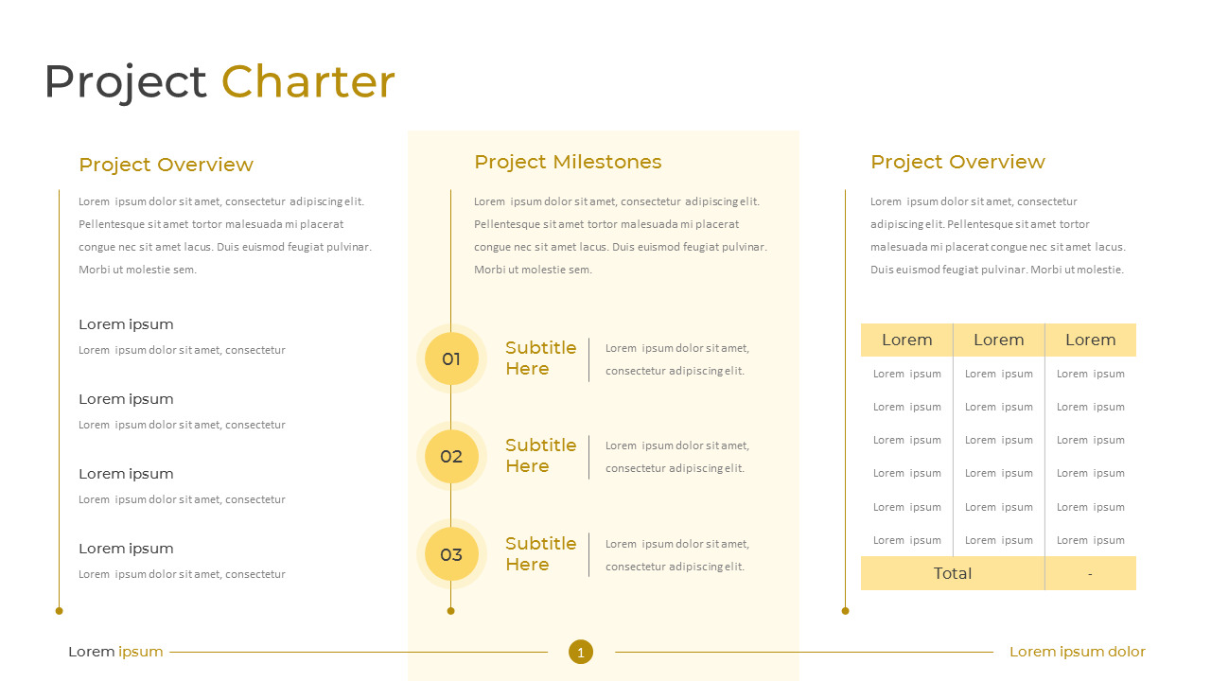
Establish the Charter
Information Technology Services| HUTCHINSON COMMUNITY COLLEGE
Notes:
The project charter is the single most important project document. A charter is a covenant granting the authority by which a project manager leads a project.
The project charter is where we -
Define the project vision
Identify the stakeholders
Organize the project structure
Document the communication plan
Record the implementation plan

Slide 5

Activity: Project Charter
Information Technology Services| HUTCHINSON COMMUNITY COLLEGE
Notes:
Practice filling out a project charter.

Slide 6
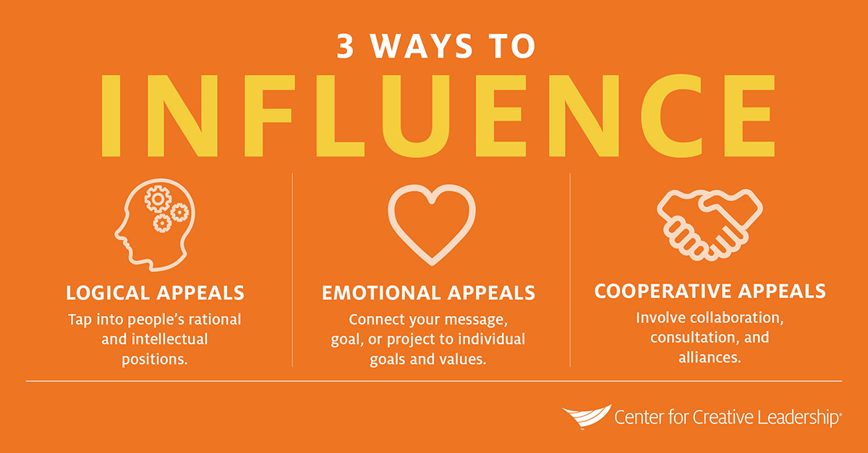
Build Influence
Information Technology Services| HUTCHINSON COMMUNITY COLLEGE
Notes:
Why do we need influence to manage projects?
Because influence is about working effectively with people over whom you have no authority. It requires the ability to present logical and compelling arguments and engage in give-and-take.
The best leaders use 4 key skills in influencing others:
Organizational intelligence – Understand your organization’s formal and informal structures. Understand how to get things done and embrace the reality of working within organizational politics to move teams and important initiatives forward.
Team Promotion – Create visibility around the work you’re doing. Leaders cut through noise to authentically and credibly promote themselves – while also promoting what’s good for the entire organization.
Trust-Building – Leadership often involves guiding people through risk and change. Trust is essential. Build and maintain trust.
Leveraging Networks – Recognize and cultivate the power of your network. Leaders are empowered by their connections.
When you’ve built influence with people, then you can influence them to support your projects in the following ways:
Logical appeals tap into people’s rational and intellectual positions. You present an argument for the choice of action based on organization benefits, personal benefits, or both.
Emotional appeals connect your message, goal, or project to individual goals and values. An idea that promotes a person’s feelings of well-being, service, or sense of belonging tugs at the heartstrings and has a good chance of gaining support.
Cooperative appeals involve collaboration (what will you do together?), consultation (what ideas do other people have?), and alliances (who already supports you or has the credibility you need?). Working together to accomplish a mutually important goal extends a hand to others in the organization and is an extremely effective way of influencing others.
Leaders who effectively use these influencing tactics can achieve their goals and objectives more successfully than leaders who lack the ability, regardless of where they sit in an organization.
How do you know what tactics are right for you? Assess the situation, know your audience, review your ability, think through your approach and be genuine. Utilizing a tactic for influencing others does not mean you are disingenuous or worse, that you are trying to gain support for something you don’t believe to be the best thing.

Slide 7
Activity: Influence Planning
Information Technology Services| HUTCHINSON COMMUNITY COLLEGE

Slide 8
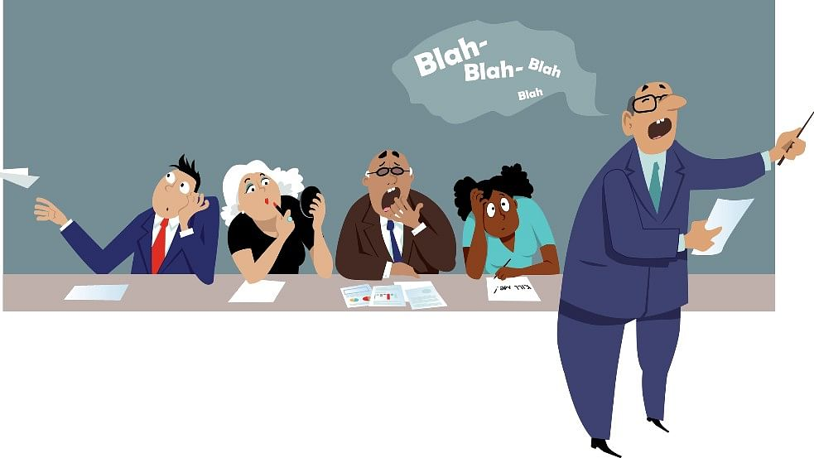
Lead Effective Meetings
Information Technology Services| HUTCHINSON COMMUNITY COLLEGE
Notes:
If I told you that only 50% of meeting time is used effectively, would you believe me? There’s evidence that remote meetings score even lower.
And get this: an ineffective meeting can derail productivity even after it’s over. Dr. Steven Roglberg, author of The Surprising Science of Meetings, examines how meetings are conducted and the effect of both good and bad meetings on participants. Dr. Rogelberg’s work suggests the existence of “Meeting Recovery Syndrome” (MRS). Attendees of poor meetings don’t leave the bad experience in the meeting room; it stays with them and negatively affects then outside the meeting. People literally lose work time while they mentally recover from a bad meeting.
A January 14 article written by Alam Rosina abour MRS -
“Meetings sap stamina from a person when they fail to engage the participants, last too long, or turn into one-sided lectures; hence taking time to recover is essential, but what if this comes at the expense of productivity. It gets even worse when the employee has too many meetings scheduled without enough time to transition. There isn't enough time to recover for the next meeting...”
Remember I mentioned that there is evidence that remote meetings score even lower in terms of effectiveness?
New studies are being conducted on “Zoom fatigue” or virtual fatigue due to the increased cognitive demands of virtual communication.

Slide 9
Lead Effective Meetings
Before you schedule a meeting –
Why have you called a meeting?
What is the cost of this meeting?
Set a clear purpose for your meeting
Craft and share an agenda that speaks to the goal of the meeting
Start on time.
Finish on time
Information Technology Services| HUTCHINSON COMMUNITY COLLEGE
Notes:
So, how can we have meetings that don’t zap our stamina? Most of us don’t have formal training in meeting management skills, but anyone can learn to do it well – whether your team is in the office, fully virtual, or hybrid.
Before you schedule a meeting, ask yourself two things
WHY have I called a meeting
If you have called a meeting to achieve something that could be done over email or to share information you could share over email, you don’t need a meeting.
If you have called a meeting to make a decision, solve a problem, get feedback, generate ideas, make a plan, or to reflect and improve…you probably need a meeting!
WHAT is the cost of this meeting?
It is especially critical to evaluate the why if you intend to invite a team of expensive vendors or the executive team. The cost of the human resources in the room can be astronomical so be strategic.
For recurring meetings, re-evaluate the necessary attendees every so often to ensure that the cost of the meeting is still warranted.
Set a clear purpose for your meeting
– Every successful meeting has a clear purpose.
Craft an agenda that speaks to the goal of the meeting.
Start on time - the published start time is when the talking starts; not when you expect people to show up.
When you begin, reiterate the objectives and who is leading the meeting
Next, appoint a note taker to record key decisions made and keep an action log (and who owns them)
Finish on time
Recap achievements
If the meeting has not achieved the desired results, schedule another meeting
Recap agreements made
Whenever possible, end on a positive note – you want team members to go back to their desks enthused, not praying for 5 o’clock
When we craft an agenda, we are not only setting the goal for our meeting, we are planning the timeframe and structure of our meeting. If pre-work is required of the attendees, be sure to distribute it with the agenda.

Slide 10
Lead Effective Meetings
Invite the right people
Who can help achieve the purpose?
What is the cost?
Maximize engagement
Schedule for max engagement
Encourage free thinking
Get commitment
Produce shareable results
Information Technology Services| HUTCHINSON COMMUNITY COLLEGE
Notes:
Invite the people that can help achieve the purpose of the meeting
It’s great to share information across the entire project team and keep everyone involved but consider the impact on productivity (and MRS)! Consider using a collaboration tool to reduce meeting attendance. (I use Teamwork.) This also eliminates the need for us, as project managers, to write and deliver status updates.
A little bit ago, we touched on the idea of how expensive a meeting can be. Keep this in mind as you invite the right people.
If you pick your attendees wisely, everyone will get something valuable from the meeting.
Maximize engagement
Scheduling - As much as possible, avoid scheduling your meeting during someone else’s lunch hour, etc. It is a good idea to check-in with people in advance to get their buy-in on the meeting time.
Encourage free thinking and free speaking
Ask the group for ideas and opinions – remember that not everyone is comfortable airing ideas or opinions in a group so ask for feedback from the room rather than calling on individuals.
Lively discussion is to be encouraged but only if it’s constructive, on-topic and moves the agenda forward
Meetings are not for resolving personal conflicts. Professionalism dictates that we tackle those things outside the meeting room.
Get assigned commitment – actions should always have an owner and an agreed deadline for completion
Create a “parking lot” for capturing ideas, topics and questions that are out of your meeting’s scope.
Produce shareable results
Re-state what has been agreed to and achieved so everyone leaces with the same understanding (put this on your agenda!!!)
Ask the designated note taker to send out the notes for everyone to review
Meetings shouldn’t be where productivity goes to die. You know the meeting’s purpose because you carafted an agenda designed to meet the goal. Now stay the course! Be careful not to get sidetracked.

Slide 11
Activity: Meeting Agenda
Information Technology Services| HUTCHINSON COMMUNITY COLLEGE
Notes:
Use the example to create a sample meeting agenda. (It might be a good idea to add a list of attendees as well.)

Slide 12
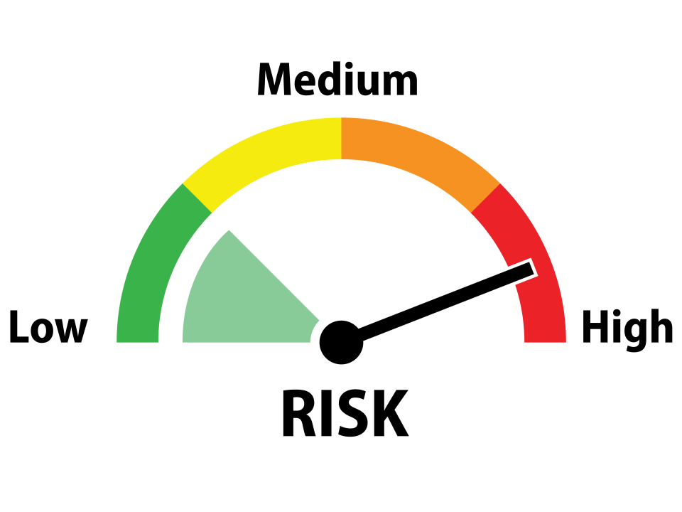
Evaluate Risks/Gaps
Identification
Probability
Moment of Risk
Treatment
Secondary Risk
Residual Risk
Monitoring and Review
Information Technology Services| HUTCHINSON COMMUNITY COLLEGE
Notes:
Evaluating risk is simply the process of identifying and measuring risk. We use 7 steps in order to do this:
Identification – Identifying our risks, what could go wrong? (May be based on what went wrong last time.)
Probability and Impact – What is the impact to the project if the thing we identified happens? Will it cost money? Will the project be delayed? Will the scope change? Or all of those?
Use a probability-impact matrix to help us determine the probability and impact of our risks.
Moment of Risk – List the specific conditions that cause the risk to be more likely to occur.
Treatment – Determine risk treatment options – acceptance, mitigation, transfer, sharing, avoidance
Acceptance – Face the risk (an investor may accept that a company may go bankrupt when you purchase its bonds)
Mitigation – Take action to recue the risk (wear a life jacket when you swim)
Transfer – transfer all or part of the risk to a third party (insurance and outsourcing)
Sharing – distribute the risk to multiple people or entities
Avoidance – avoid the actions that cause the risk (if you cannot swim, don’t swim)
Secondary Risk – Evaluate risks caused by treatments (some efforts to reduce risk have a risk of their own – if you outsource a project, you assume the risk that the outsourcing company will fail to deliver)
Residual Risk – Calculating the probability and impact of remaining risk after treatment. (risk treatments don’t necessarily reduce risk to 0)
Monitoring and Review – Identify new risks that become clear as a project progresses.

Slide 13
Activity: Identify Risks
Information Technology Services| HUTCHINSON COMMUNITY COLLEGE
Notes:
Use the example to identify risks in a project or task that you are currently working on.

Slide 14
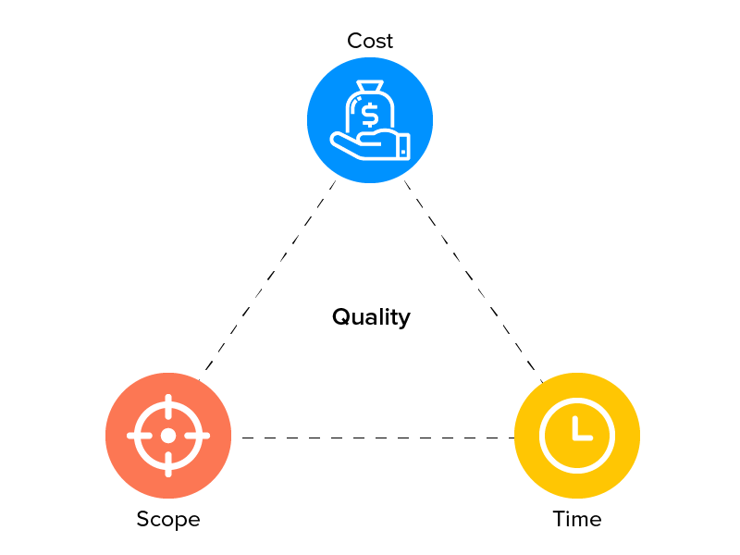
Manage Change
Submission/logging
Evaluation
Decision
Integration
Communication
Information Technology Services| HUTCHINSON COMMUNITY COLLEGE
Notes:
Projects have a tendency to grow in size and detail (we call this “scope creep”). When the scope changes, the time and resources it takes to meet the scope also change, and we end up with the “never-ending project”, similar to the never-ending story but without the cool theme song. To prevent this, we implement a change management process.
The purpose of a change management process is to control project changes, so we can complete projects on time and in budget, and with minimal disruption.
The four main types of project change management are:
Anticipatory – planning changes in advance of an expected situation (a senior employee hands in their notice)
Reactive – when an unforeseen event occurs (not ideal and often used in emergency situations)
Incremental – gradual changes over a prolonged period of time (ongoing addition of new features to an existing app)
Strategic – larger changes that can change organizational direction (new technology that requires a rewrite of the original project charter)
A change management plan serves as the guide for implementing and executing the change management process. The change management plan should include:
Project constraints – max budget, deadline, minimum viable deliverable
Change management guidelines – what items are subject to change management? What latitude does the project team have to interpret requirements?
Estimate of change and volume – how many hours will this change consume? How many dollars?
Roles and responsibilities – who will act as the evaluator of the change? Who approves the change? (usually the project sponsors)
Change management process – what steps are taken to submit and evaluate the change
Tools – change request form, change log
Change Management Process:
Submission and logging (change request and change log)
Evaluation (evaluate the change request)
Decision (should we make the change or no? project sponsor sign off)
Integration (how do we integrate the change into the existing project tasks?)
Communication (what is the plan for communicating out the change?)

Slide 15
Activity: Change Management Plan
Information Technology Services| HUTCHINSON COMMUNITY COLLEGE
Notes:
Use the example provided to create a change management plan.
Change Management Plan – Sample.docx
Change Request – Sample.docx
Change Log.xlsx

Slide 16
The 5 Basics
Establish the charter
Build influence
Run effective meetings
Evaluate risks/gaps
Manage change
SUCCESS!!!
Information Technology Services| HUTCHINSON COMMUNITY COLLEGE
Notes:
We have spent this time focusing on 5 fundamentals in project management that you can take back with you and implement immediately.
“All compromise is based on give and take, but there can be no give and take on fundamentals. Any compromise on mere fundamentals is a surrender. For it is all give and no take.”
-Mahatma Gandhi
How will basic project management skills help me?
- Everything in a given discipline, including project management, relies on the fundamentals. They are the foundation from which our successes derive.
- Perfecting the fundamentals often leads us to becoming skilled practitioners.
With repetition and practice, you can become expert at applying the basics to your projects.
What happens if we ignore the basic skills?
Typically, we experience a failure.
“I fear not the man who has practiced 10,000 kicks once, but I fear the man who has practiced one kick 10,000 times.”
-Bruce Lee

Slide 17
Questions???
Information Technology Services| HUTCHINSON COMMUNITY COLLEGE

